Slide 1
Odoo Internship
Assessment
Functional • AI • Basic Development
Demo Company: Arindam Enterprise
Prepared by Arindam Das
70% Functional
20% AI
10% Development
5-Day Learning & Practical Assessment

Slide 2
Assessment Overview
What the five-day assessment covered
OVERVIEW
Odoo Functional
AI Learning
Basic Development
CRM • Sales • Purchase • Inventory • Invoicing • Project
AI concepts • prompts • verification • responsible use
Module structure • Python • XML • ORM • access rights
Objective: demonstrate practical business-process understanding, learning ability, problem solving, communication and responsible AI use.
Learn
Configure
Execute
Verify
Explain

Slide 3
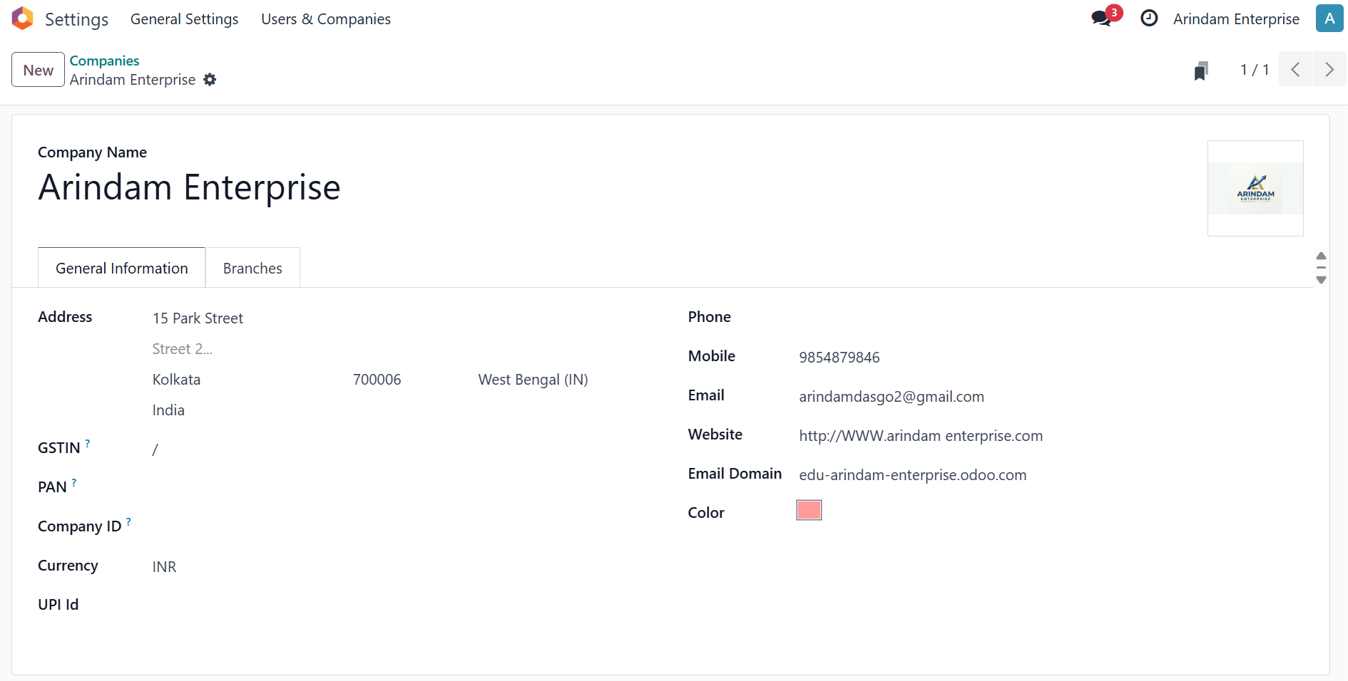
Company & Master Data
Core setup evidence from the Odoo demo
MASTER DATA
Company configuration — Arindam Enterprise
Configured company basics, customer/vendor contacts, products, categories and employees.

Slide 4
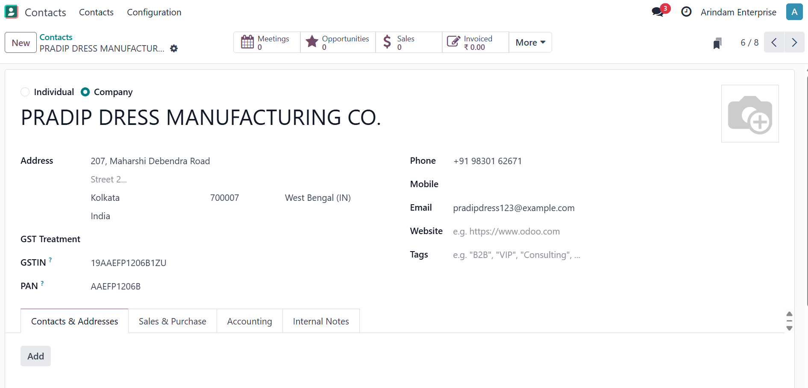
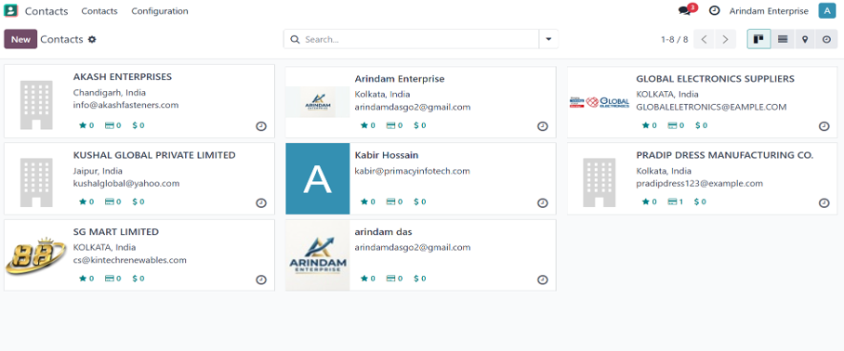
Contact creation & contact list:
Contacts are one of the most essential part in Odoo.
We need many important contacts like customers and vendors to run Odoo functions.
Customer/contact list

Slide 5
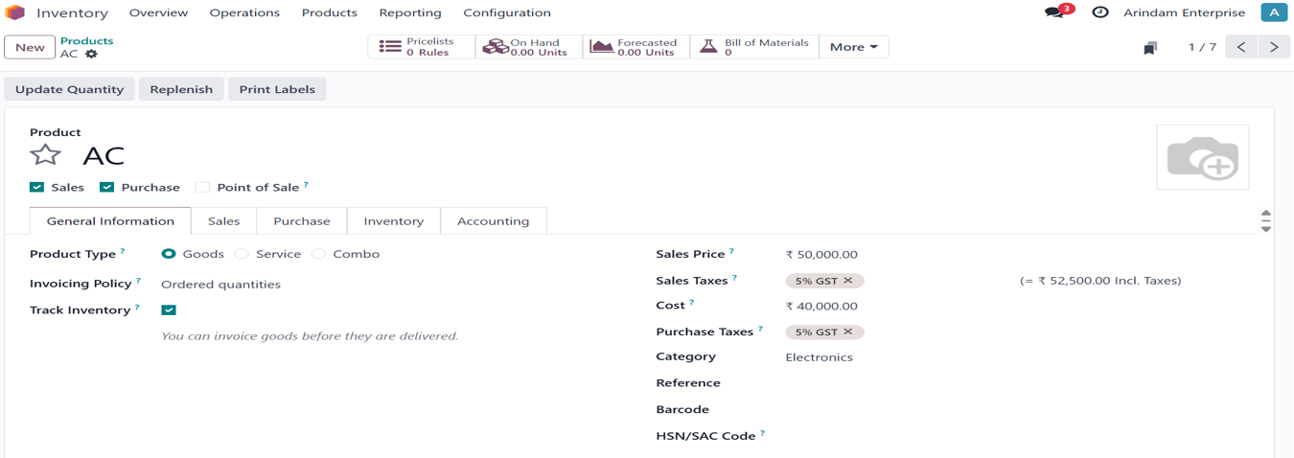
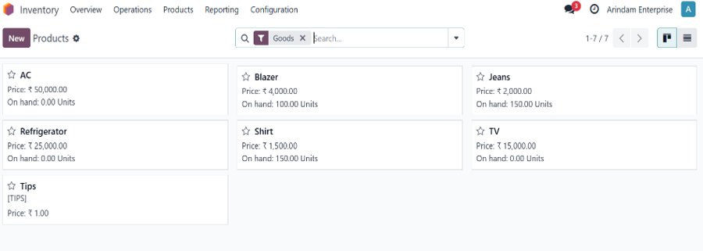
Product creation & inventory overview:
products are one of the most essential part in Odoo.
We need them to sell for profit ,as without a product a company is just a shell.

Slide 6
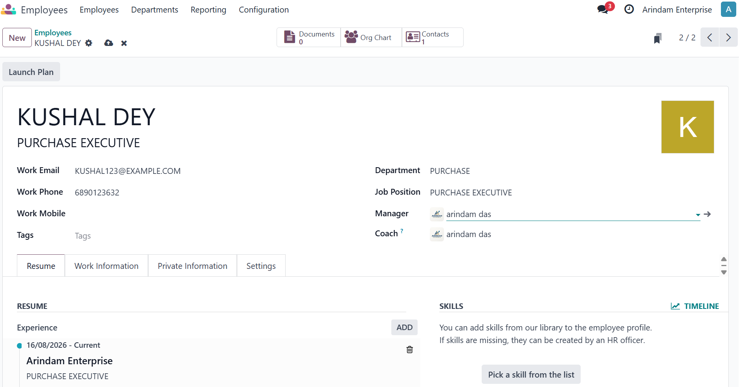
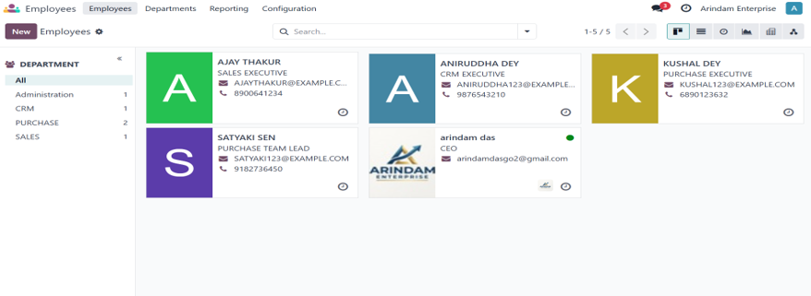
Employee creation & Employee List:
Employees are one of the most essential part in Odoo.
We need them to properly manage and run the business, some key applications include CRM.
Employees including Sales / Purchase roles

Slide 7
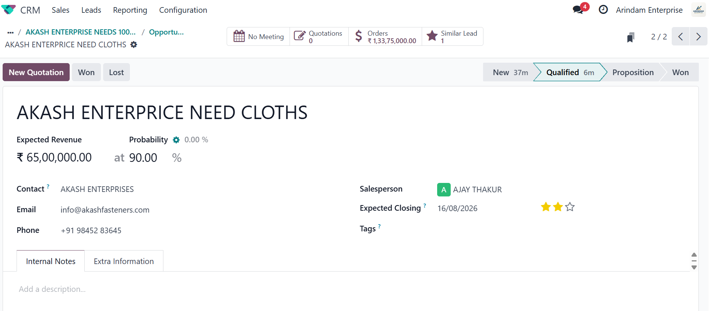
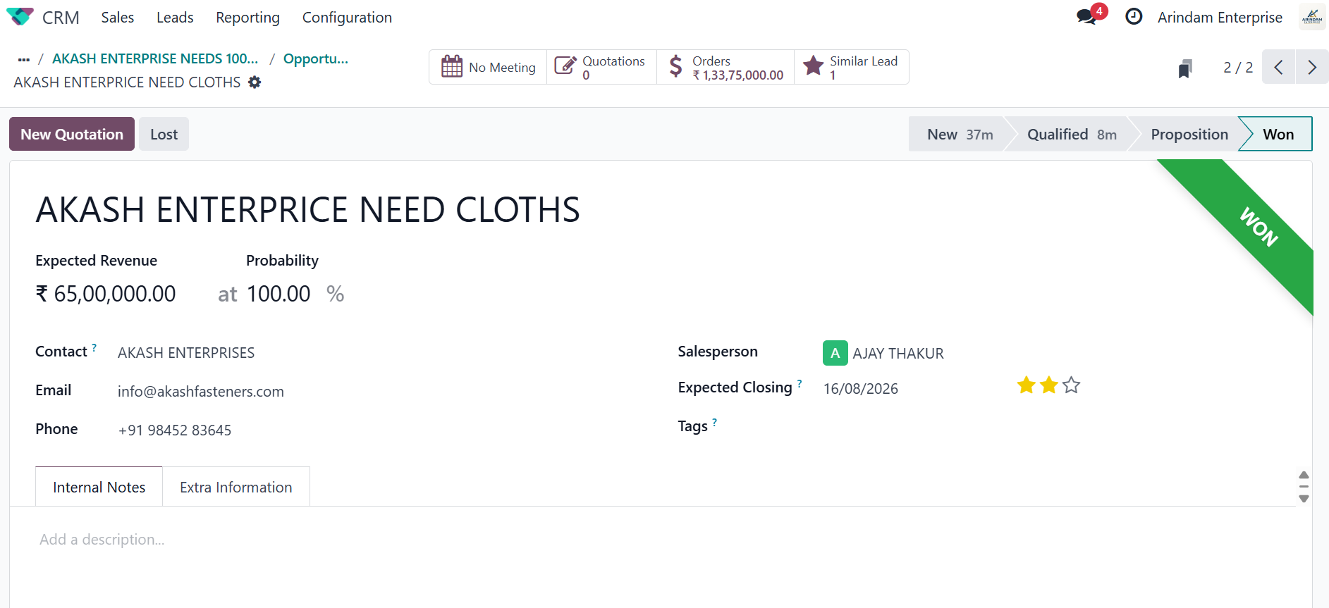
CRM Workflow
From lead qualification to a won opportunity
CRM
Lead
Opportunity
Qualified
Quotation
Won
Opportunity with expected revenue, salesperson and expected closing date
Opportunity marked Won
Lead = initial potential customer information; Opportunity = qualified sales possibility.
Salesperson assignment, expected revenue, closing date and follow-up activities support pipeline management.
The opportunity moves through stages and can generate a quotation; after successful sales confirmation it can be marked Won.

Slide 8
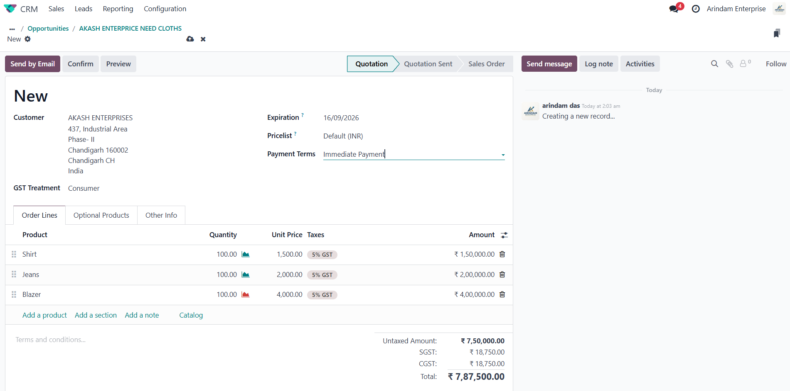
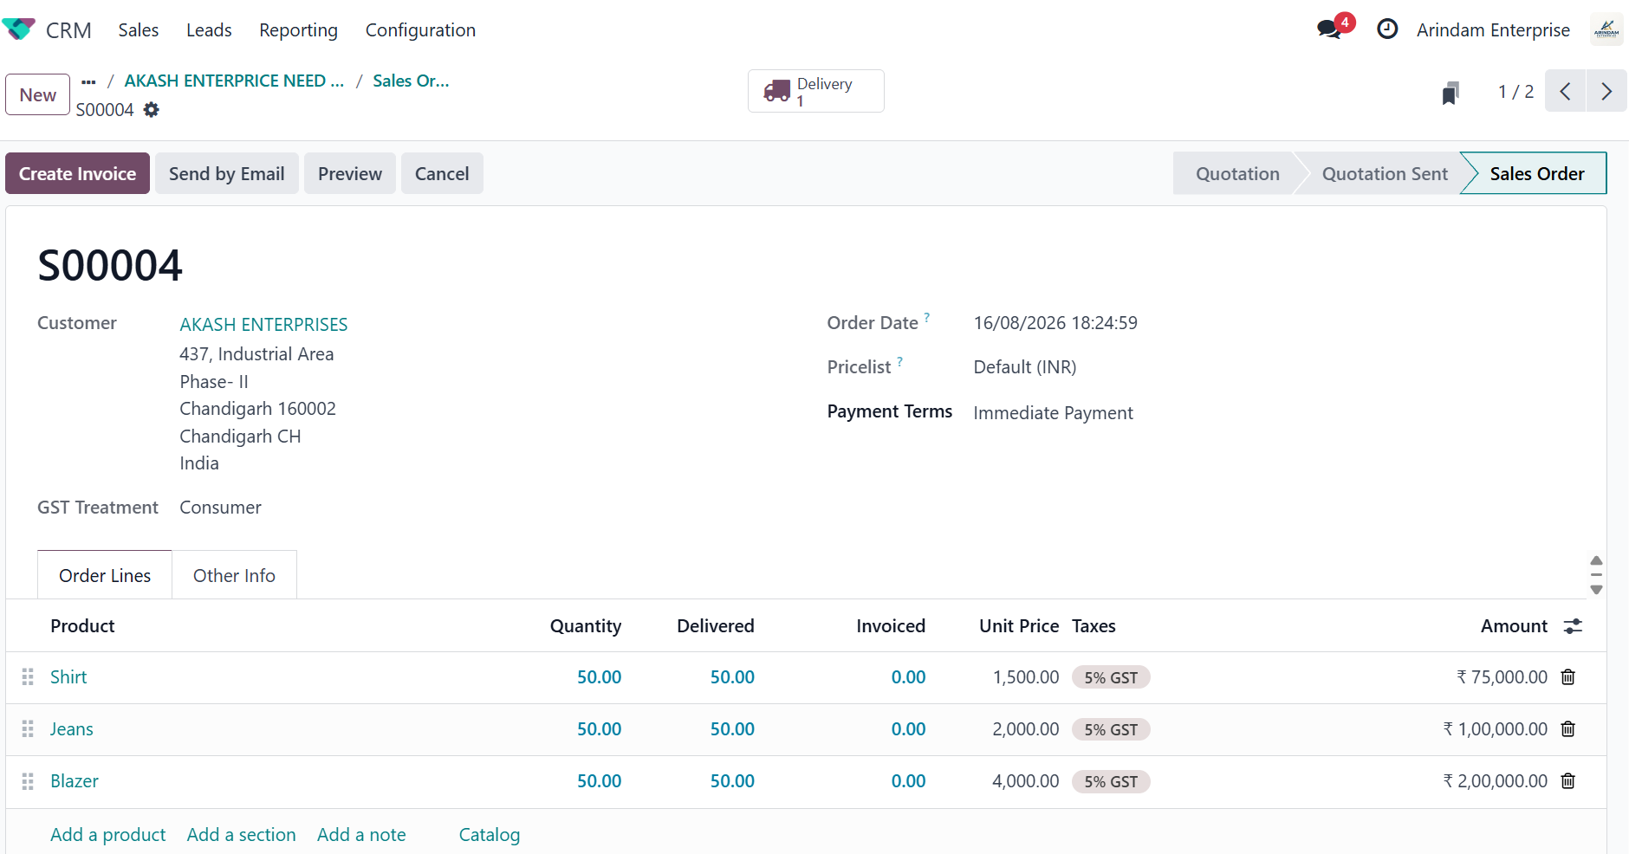
Sales Workflow
End-to-end customer order cycle
SALES
Quotation
Sales Order
Delivery
Invoice
Payment
Commercial order is confirmed in Sales → physical stock movement is handled by Inventory → billing and settlement are handled by Invoicing/Accounting.
Quotation: customer, 3 products, quantities, prices and GST
Sales Order: ordered vs delivered vs invoiced quantities

Slide 9
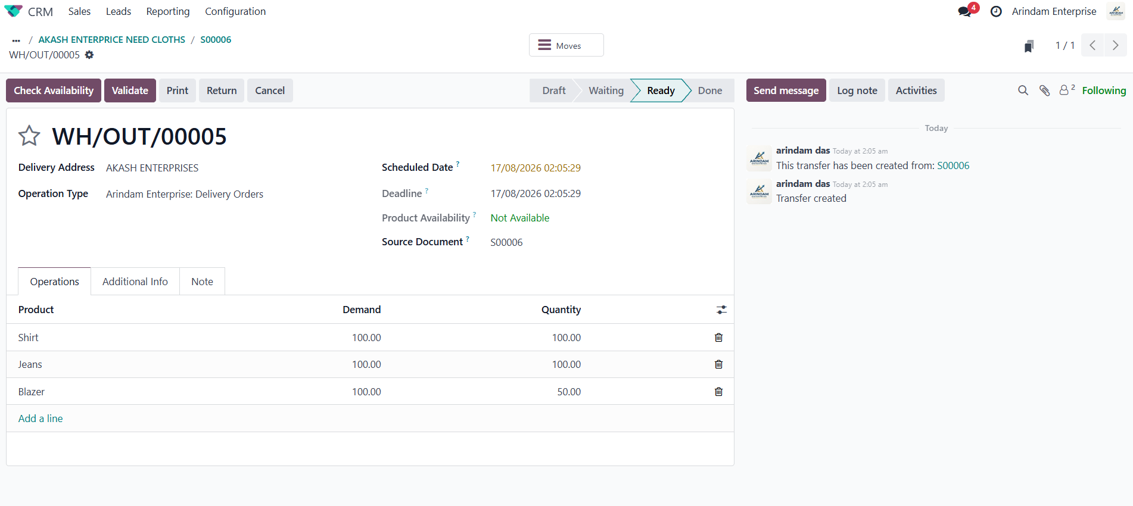
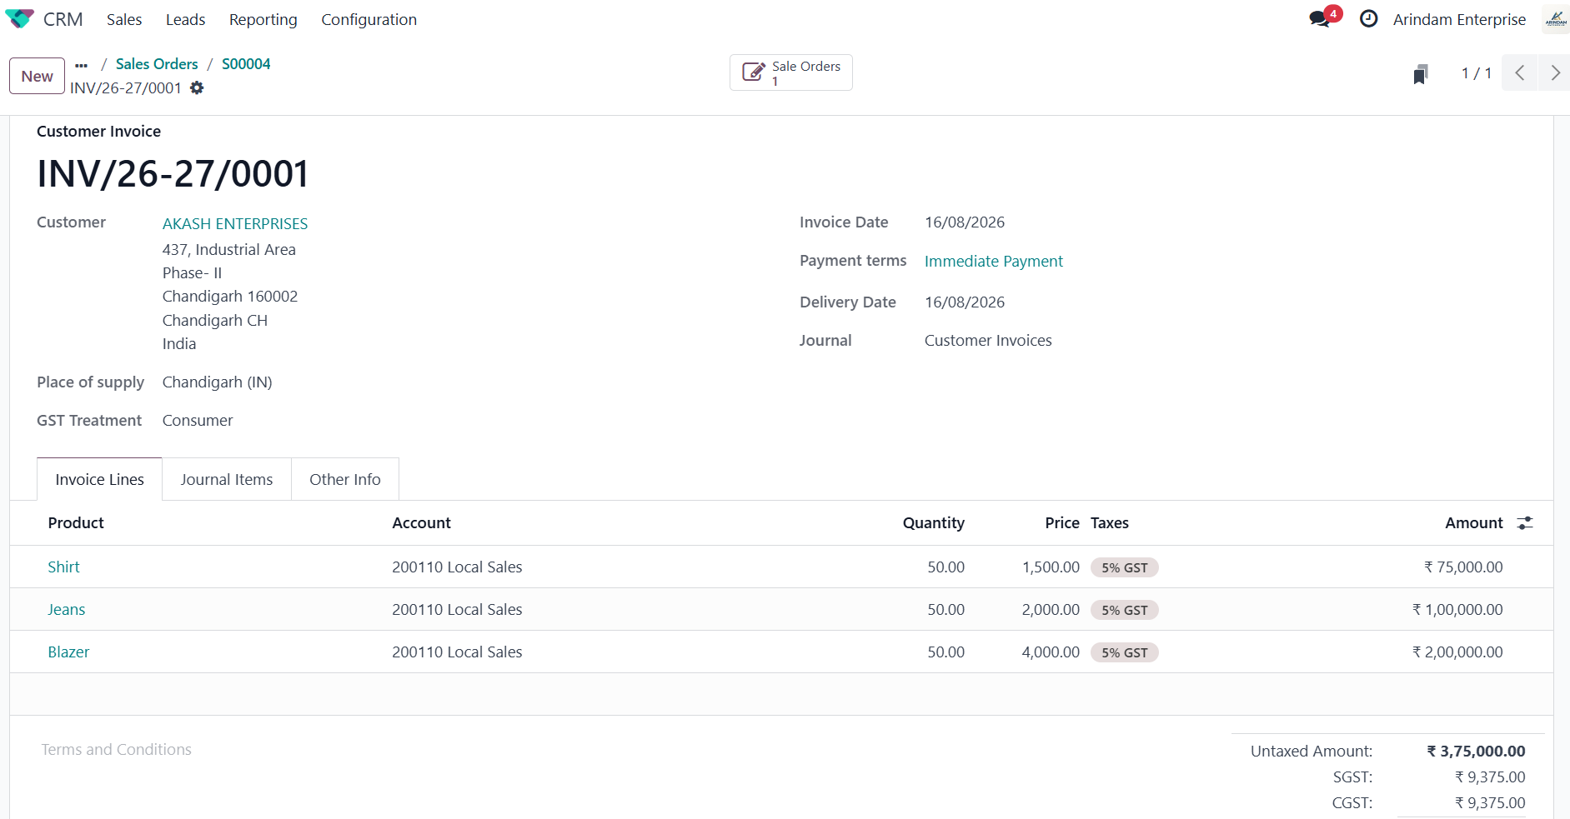
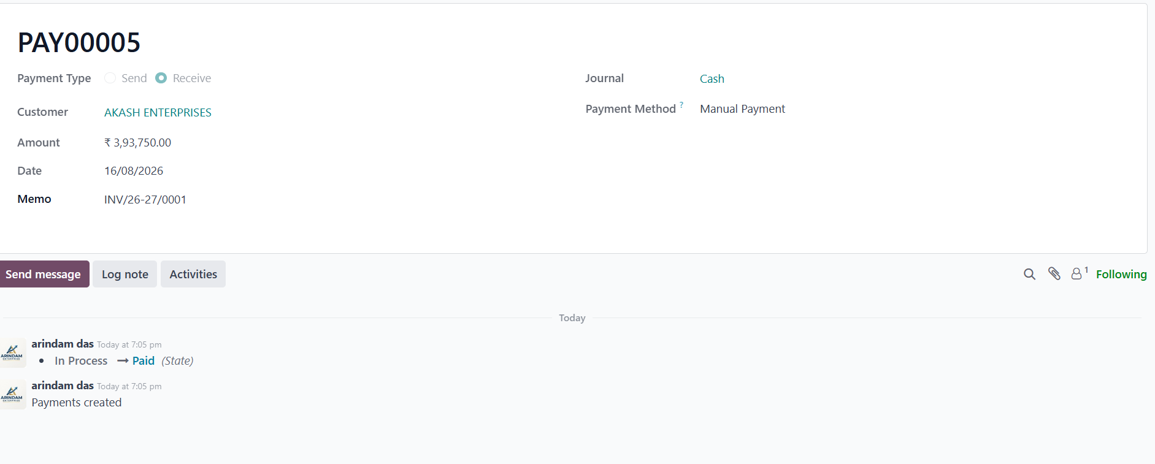
Sales — Delivery, Invoice & Payment
Evidence that the commercial workflow reached fulfillment and settlement
SALES EVIDENCE
Delivery Order created from Sales Order
Customer Invoice with invoice lines and GST
Key concepts: quotation vs sales order • ordered vs delivered quantity • delivery order • customer invoice • payment status.
Customer payment registered — status Paid

Slide 10
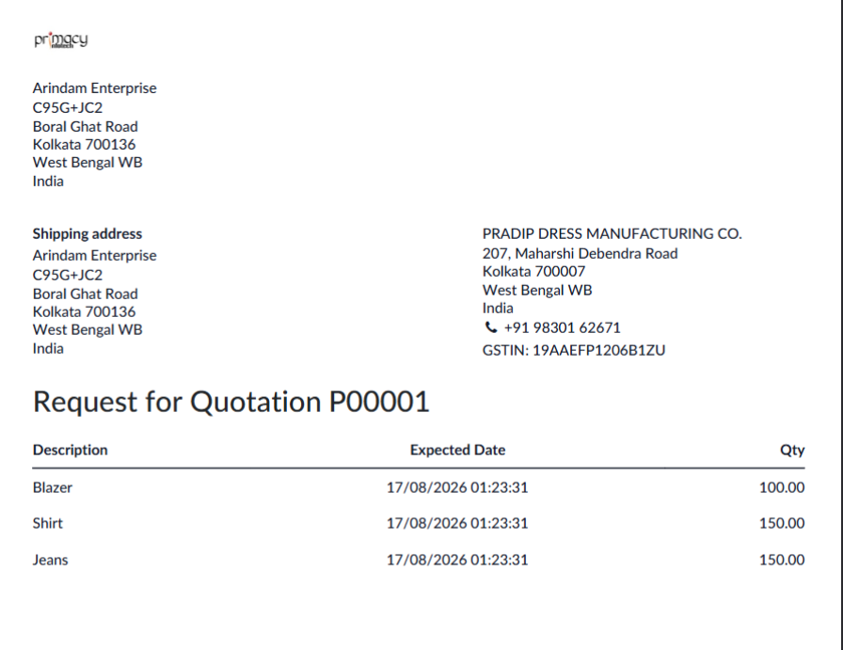
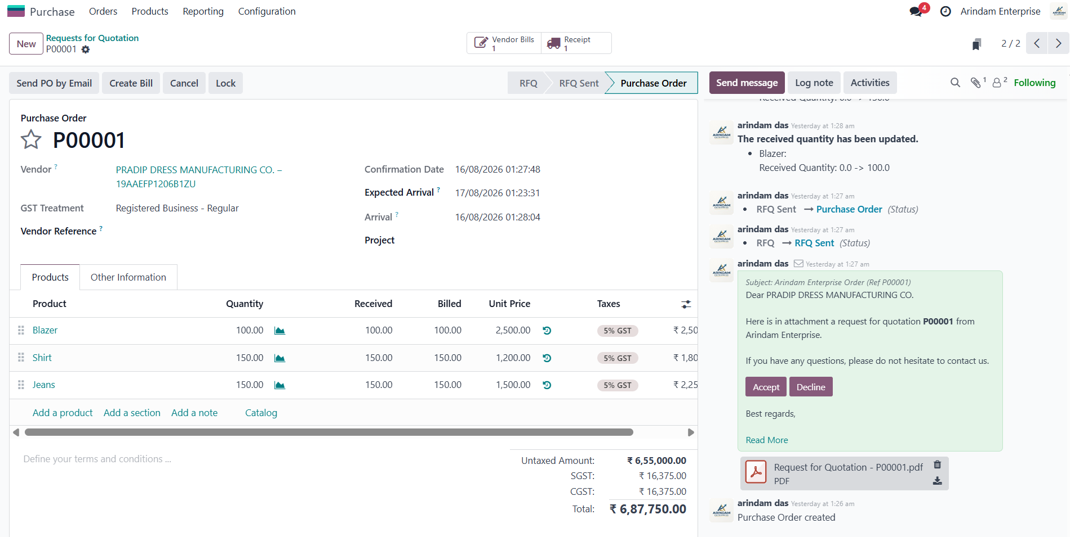
Purchase Workflow
From vendor RFQ to vendor payment
PURCHASE
RFQ
Purchase Order
Receipt
Vendor Bill
Payment
Request for Quotation — vendor and product quantities
Purchase Order — confirmed quantities and receipt/vendor bill links
Purchase integrates with Inventory through receipts and with Accounting through vendor bills and payments.

Slide 11
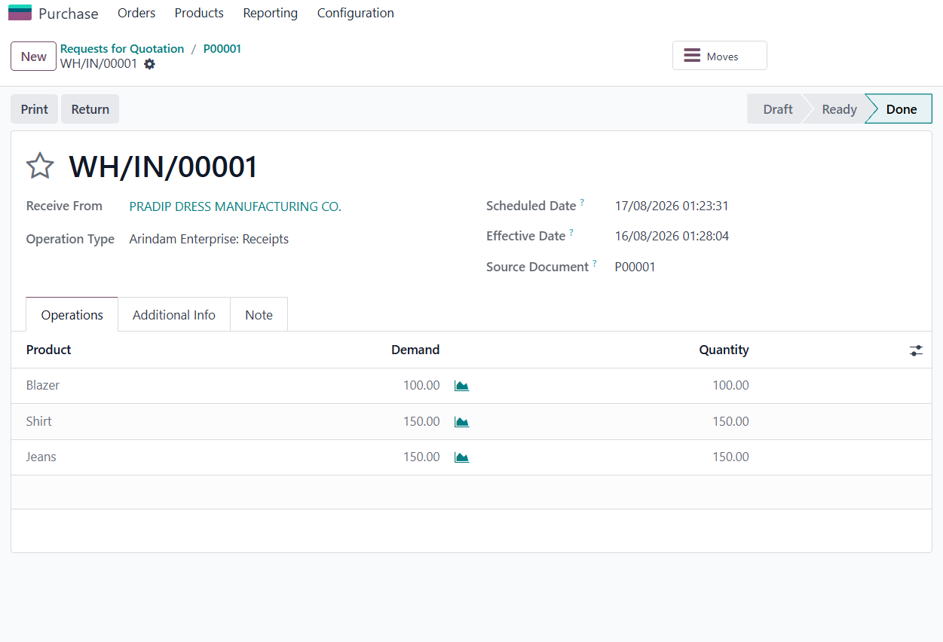
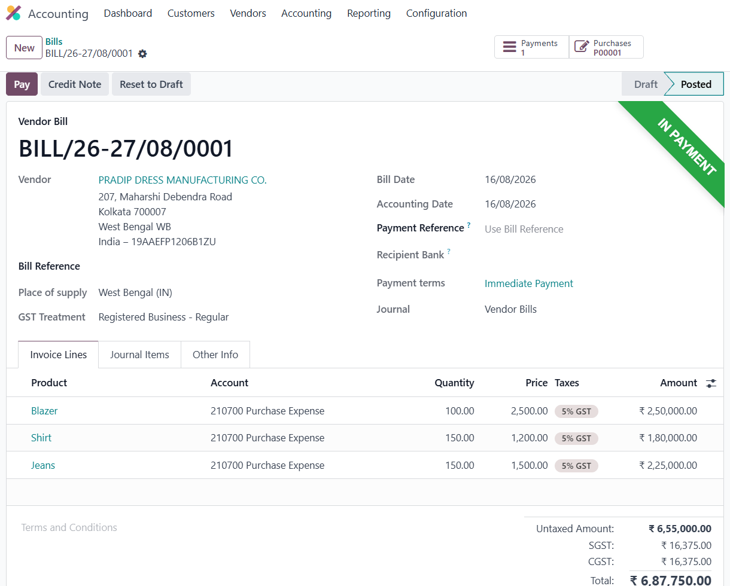
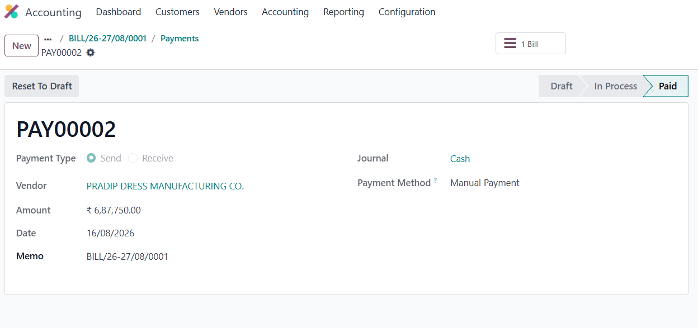
Purchase — Receipt, Bill & Payment
Proof of completed procurement cycle
PURCHASE EVIDENCE
Validated receipt — status Done
Vendor Bill — posted and linked to Purchase Order
Key concepts: RFQ vs Purchase Order • vendor selection • product receipt • vendor bill • payment • Purchase/Inventory integration.
Vendor payment — status Paid

Slide 12
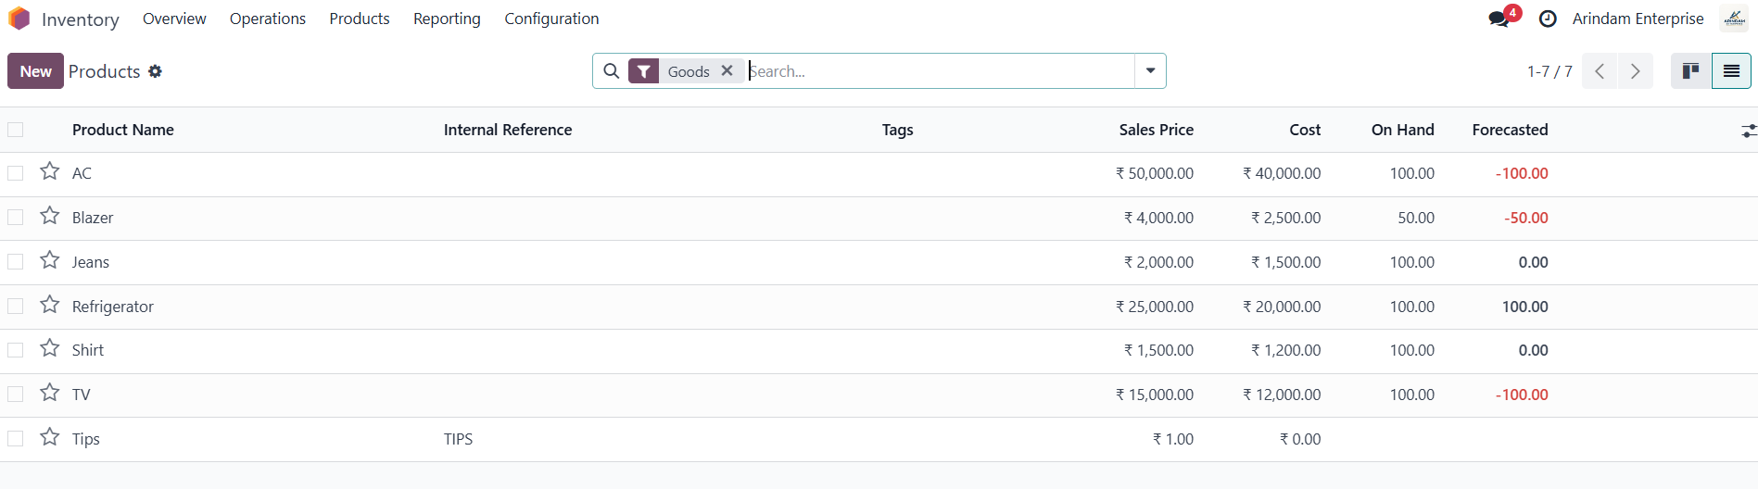
Inventory Management
Stock position and movement across Sales and Purchase
INVENTORY
Product list showing Sales Price, Cost, On Hand and Forecasted quantities
On-hand quantity shows current physical stock recorded by Odoo.
Forecasted quantity reflects expected future availability after planned incoming/outgoing moves.
Sales deliveries reduce stock; purchase receipts increase stock.
Basic lot/serial tracking links traceability to individual batches or units where configured.

Slide 13
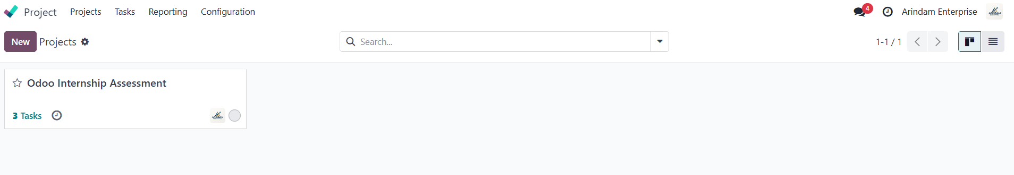
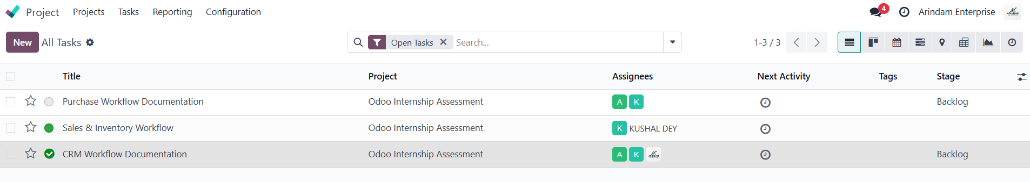
Project & Task Management
Practical setup completed in Odoo Project
PROJECT
Project created: Odoo Internship Assessment
Three tasks with assignees and stages

Slide 14
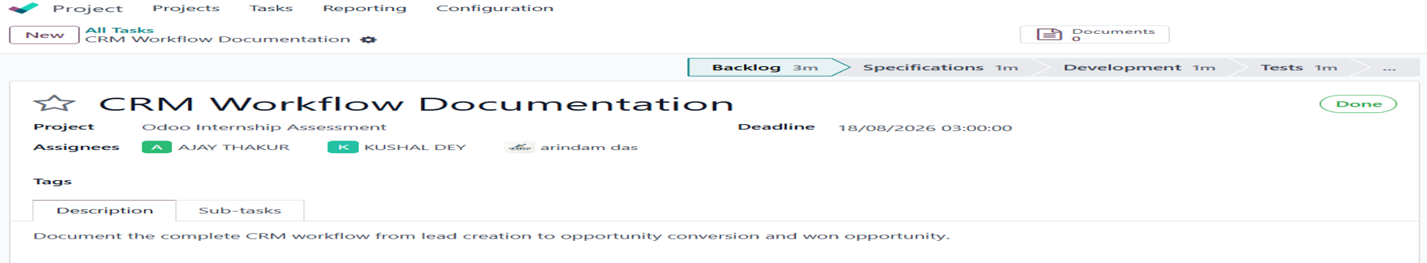
Task created with assignees deadline and project
Task detail: assignees, deadline, description and completed stage
Demonstrated: project vs task • task assignment • deadlines • task stages • basic completion tracking.

Slide 15
How the Odoo Modules Connect
One integrated business process
INTEGRATION
CRM
Invoicing
Payment
Sales
Inventory
CRM manages potential business. Sales confirms the customer order. Inventory fulfills it through delivery. Invoicing records the customer receivable. Payment settles the receivable.
Purchase
Receipt
Inventory
Vendor Bill
Vendor Payment
Purchase reverses the direction: procurement creates an incoming receipt, increases stock, generates a vendor payable, and ends with payment.

Slide 16
AI Practical Work
Prompting, improving the prompt, and interview preparation
AI
Prompt 1 — Initial
Prompt 2 — Improved
Explain the complete Odoo Sales workflow from quotation creation to customer payment. Explain each step in simple language and mention how Sales, Inventory, Delivery, Invoicing and Accounting are connected.
I am preparing for an Odoo Functional Consultant interview. Explain the complete Odoo Sales workflow step-by-step using Quotation → Sales Order → Delivery Order → Delivery Validation → Customer Invoice → Payment Registration. For each step, explain the purpose, important information, status change and effect on Inventory and Accounting. Present the answer in a clear table followed by a simple real-world example.
Prompt 3 — Interview Questions
What I observed
Create five Odoo Functional Consultant interview questions covering CRM, Sales, Purchase, Inventory and Invoicing. Provide concise model answers and include practical scenario-based questions.
The improved prompt produced a more structured, interview-friendly response.
The AI output was checked against the actual Odoo Sales workflow I performed.
AI was useful for learning, summarizing and generating practice questions.
Key lesson: better prompts give clearer answers; important Odoo guidance still needs verification.

Slide 17
AI Verification & Responsible Use
Using AI as an assistant — not as an unquestionable source
AI
Odoo Problem Used for Verification
AI Suggested Checks
Delivery Order showed “Product Availability: Not Available”. I asked AI what could cause this and what to check.
On-hand quantity
Forecasted quantity
Stock movements / reservations
Incoming receipts
My Verification
Warehouse / source location
I compared the AI suggestion with my actual Inventory and Delivery screens. The workflow and stock checks were relevant to the “Not Available” message observed in the demo.
Do Not Share with Public AI Tools
Verification Rule
Passwords / API keys / tokens
Verify important AI-generated information against the actual Odoo environment, official Odoo documentation, or another trusted source.
Confidential customer or employee data
Private financial or contractual information
Proprietary code or internal business documents

Slide 18

Challenges & What I Learned
REFLECTION
Key takeaways from the five-day assessment
Challenges Faced
What I Learned
Overall lesson:
Odoo is valuable because it connects business functions in one system; strong functional understanding comes from practicing the complete workflow, not memorizing isolated screens.
Understanding how modules are connected
CRM pipeline and opportunity management
Following status changes from draft to confirmed/paid
End-to-end Sales and Purchase workflows
Tracking inventory after Sales and Purchase
Inventory quantities and stock movements
Interpreting Odoo screens and terminology
Project tasks, AI prompting and responsible verification

Slide 19
Conclusion
A five-day practical journey from business process understanding to workflow execution and AI-assisted learning.
CRM
Sales
Inventory
Purchase
Invoicing
Project
I can now explain the purpose of each major Odoo step, trace how a transaction moves across modules, and use AI to support learning while verifying important information.
70% Functional
20% AI
10% Development
Thank you

